Slide 1
Dances, Duets, and Debates: Analysing elite political communication on TikTok
Natalia Umansky (UZH), Johannes Gruber (UvA), Jason Greenfield (NYU), Christian Pipal (UZH), and Aleksandra Urman (UZH)

Slide 2
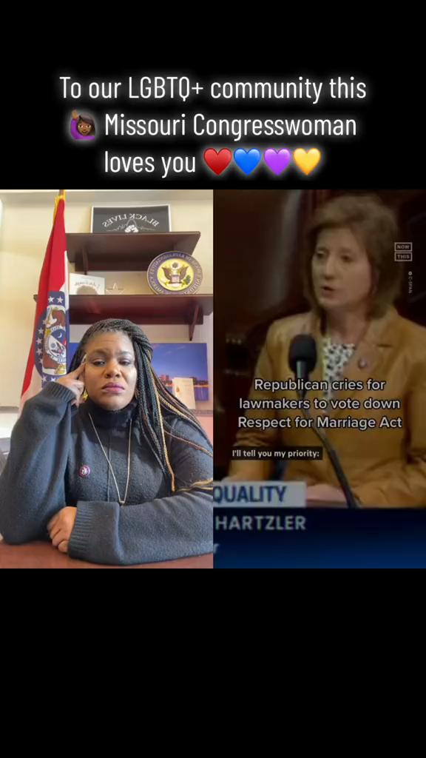
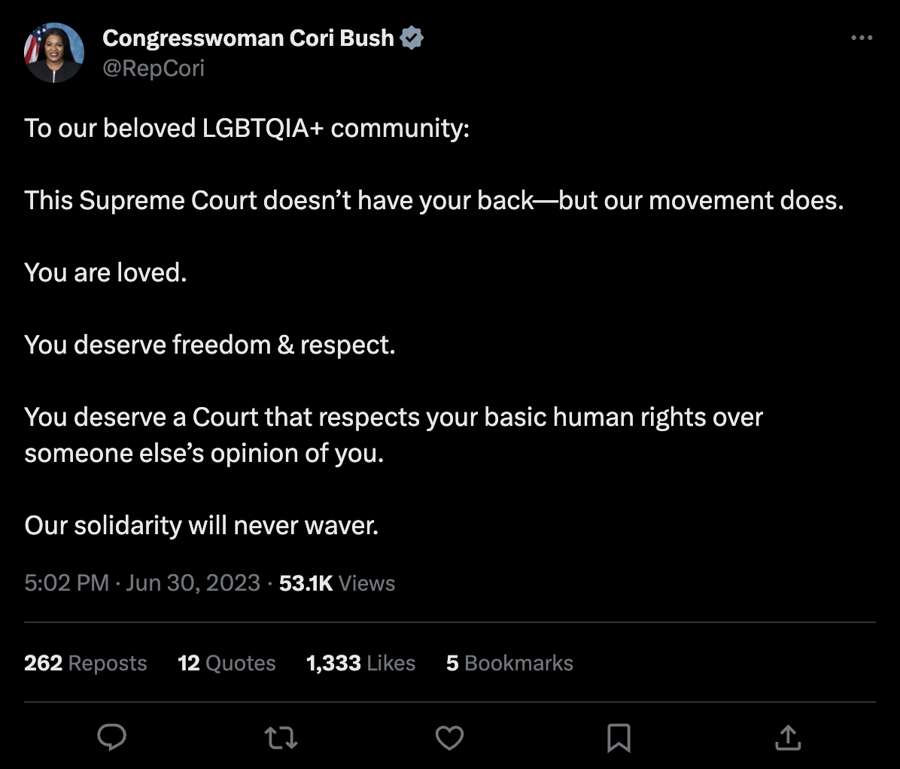




Slide 3

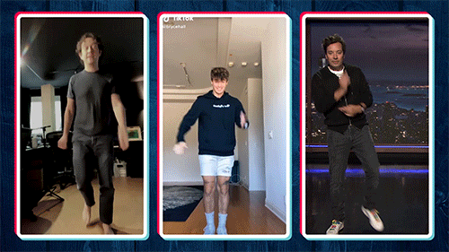


Notes:
TikTok successfully combines the most popular affordances of other better-known platforms:
the televisual medium;
algorithmic recommendation that structures the user’s experience;
and a scrolling feed that makes it easier for users to find content they are interested in.

Slide 4
Political content may play out differently on TikTok because:
Content types, i.e., short-form videos on TikTok versus a blend of text and image-oriented content.
Young audience.
Unique digital culture.
Differences in the supply mechanisms: TikTok videos are predominately delivered through algorithmic recommendation.

Slide 5
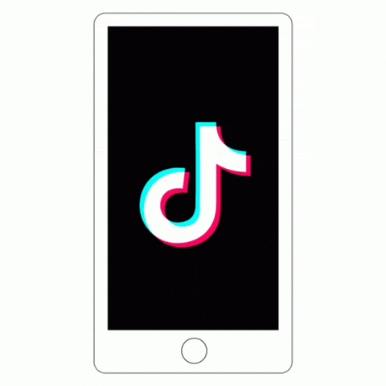
1. What do politicians say? 2. How do they say it? 3. How does it affect engagement?

Slide 6
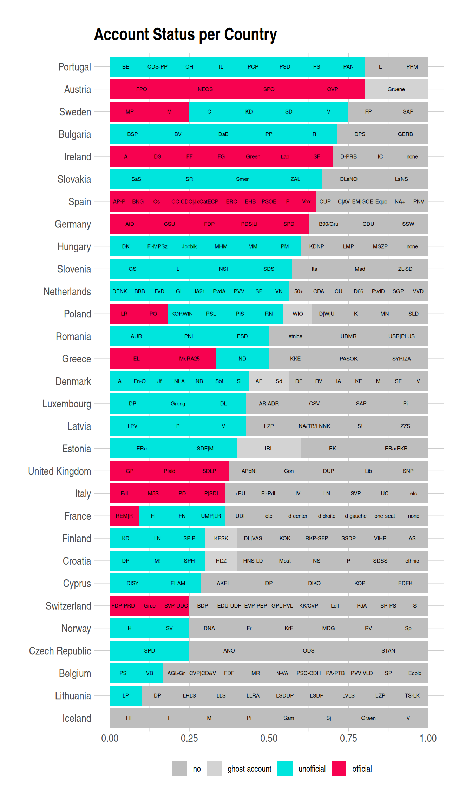
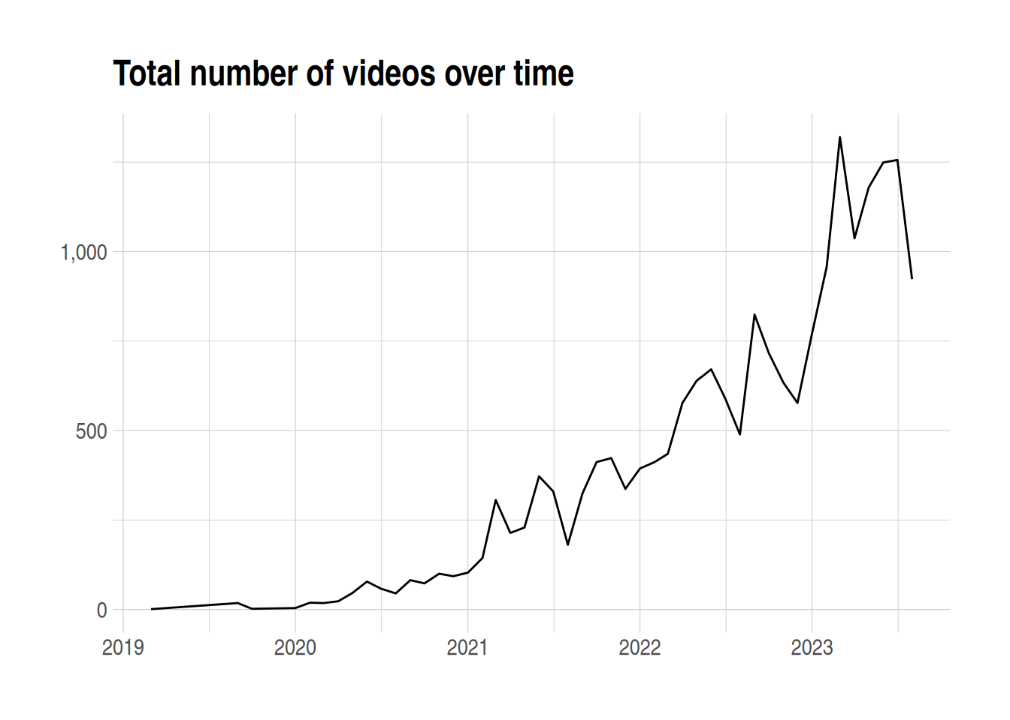
Dataset: Political parties across Europe
20,420 videos
by 116 political parties

Slide 7
Pipeline – communication style

Slide 8

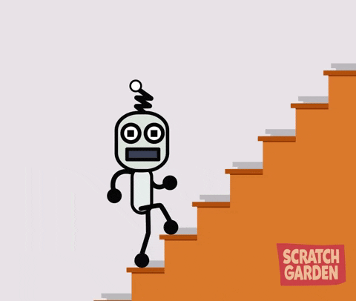
Next steps:
Collect videos
Extract text with OCR and Whisper
Run BERTopic on the transcriptions
Scene detection (split videos into scene frames, and extract images from scenes)
Generate embeddings from images
Generate embeddings from audio
Combine embeddings
Cluster embeddings
Release package

